Slide 1

HUM 102 Report Writing Skills
Lecture 09

Slide 2

Previous Lecture
Traits in technical writing
Clarity
Conciseness

Slide 3




Objectives/Traits in Technical Writing
How to enhance the probability of comprehension for the audience?
Clarity
Conciseness
Accessible Document Design (necessary info)
Audience Recognition (specified)
Accuracy (grammar)

Slide 4
Objectives/Traits in Technical Writing
How to enhance the probability of comprehension for the audience?
Clarity
Conciseness
Accessible Document Design (necessary info)
Audience Recognition (specified)
Accuracy (grammar)

Slide 5


Accessible Document Design
What makes a document accessible?
Regarding course code HUM987, we received 41 documents following style #2312-1. These were rejected. For the same code, we received 23 documents following style #2312-9. These were accepted. Forty five documents following style #2312-5 from the same course code. These were accepted. Next, 21 of course code HUM989’s documents following style #2312-8 were accepted. However, the 14 documents of style #2312-4 (same course code) were rejected. Finally, all 57 documents following style #2312-2 were rejected. These were also for course code HUM989

Slide 6

Accessible Document Design
The paragraph: 80 words or 10 sentences.
Average words/sentence: 8.0
Next, the text is clear, due to specificity of detail.
However, despite the clarity and conciseness, this writing fails. Why?
Essentially, this paragraph is unintelligible. Reason?
The page layout makes it nearly impossible.

Slide 7
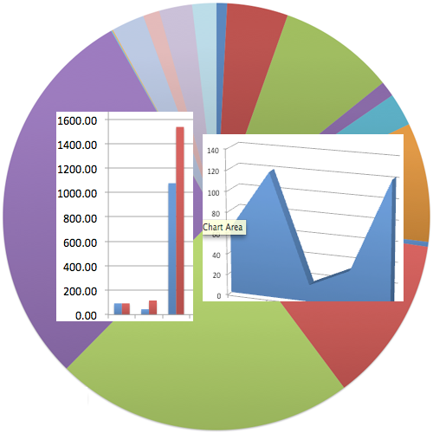
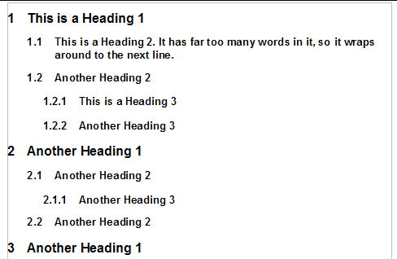
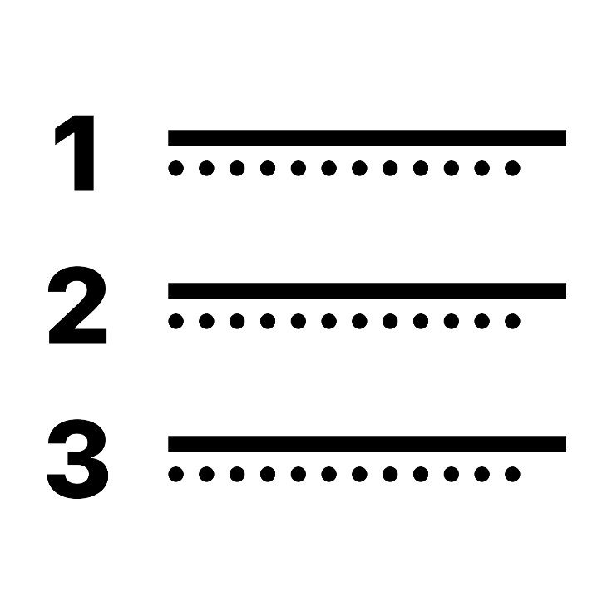

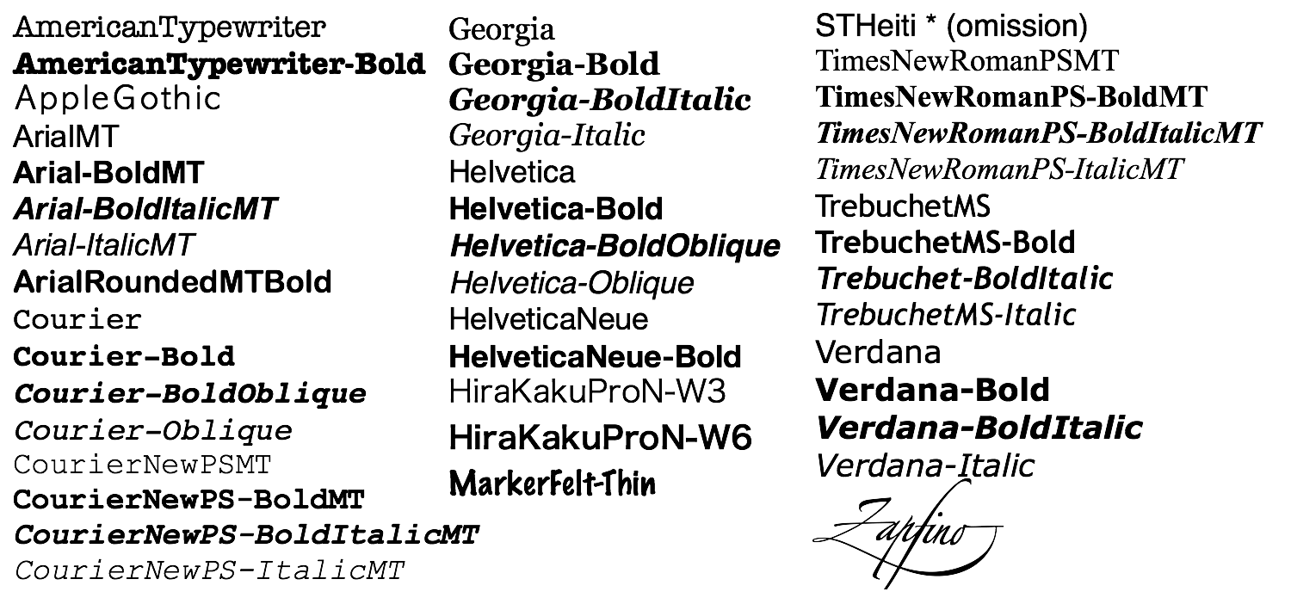
Accessible Document Design
Use highlighting techniques
Graphics (tables and figures)
White spaces
Boldface text
Headings and subheadings
Italics
Underlining
Varied font sizes
Bullets
Numbered lists
Varying font types

Slide 8

Accessible Document Design
Course Code HUM987
Document Style# | Quantity Received | Accepted | Rejected
2312-1 | 41
2312-2 | 57
2312-4 | 14
2312-5 | 45
2312-8 | 21
2312-9 | 23

Slide 9
Objectives/Traits in Technical Writing
How to enhance the probability of comprehension for the audience?
Clarity
Conciseness
Accessible Document Design (necessary info)
Audience Recognition (specified)
Accuracy (grammar)

Slide 10
Objectives/Traits in Technical Writing
How to enhance the probability of comprehension for the audience?
Clarity
Conciseness
Accessible Document Design (necessary info)
Audience Recognition (specified)
Accuracy (grammar)

Slide 11


Audience Recognition
Objectives
To inform
To generate
Clearest document for audience

Slide 12
Audience Recognition
Audience Involvement
Personalized Tone
Readers Benefit
Involve your reader
State benefit directly

Slide 13
Audience Recognition
High Tech Audience
Low Tech Audience
Lay Audience
Multiple Audience
Multi-level
Multi-cultural

Slide 14
Audience Recognition
High Tech Audience
Low Tech Audience
Lay Audience
Multiple Audience
High tech readers require minimum detail regarding standard procedures and for mathematical or technical theories.
High tech peers read to discover new technical knowledge or for updates regarding the status of a project.
High tech readers need little background information regarding a project's history or objectives unless the specific subject matter of the correspondence is new to them.

Slide 15
Audience Recognition
High Tech Audience
Low Tech Audience
Lay Audience
Multiple Audience
Characteristics
These are the people working in your field of expertise, in your department, in the same capacity, either in your company or any other. E.g. You …Peer
Require minimal details.
Experts in field you are writing about.
Read to discover new techniques, knowledge and for updates.
Share your level of understanding so you need not explain things.

Slide 16
Audience Recognition
High Tech Audience
Low Tech Audience
Lay Audience
Multiple Audience
Low tech audience are familiar with the technology you are using but their job responsibilities are peripheral to the subject matter. They either work in another department, manage your work under your supervision or work outside your company.
They understand some abbreviations, jargon, and technical concepts. To ensure that readers understand your content therefore, define your terms. An abbreviation like VLSI can not stand alone; define it parenthetically (very large scale integration).
Since low tech reader is not in your normal writing domain, i.e., as someone to whom you don’t write often regarding your field of expertise, you need to provide more background information.

Slide 17
Audience Recognition
High Tech Audience
Low Tech Audience
Lay Audience
Multiple Audience
Characteristics
These are co-workers in other departments e.g. director, subordinates.
Familiar with the technology you are writing about but their job is different.
Provide background information, i.e., introduction.
Familiar with the subject matter but you need to define technical terms, i.e., acronyms, abbreviations, jargons.

Slide 18
Audience Recognition
High Tech Audience
Low Tech Audience
Lay Audience
Multiple Audience
Lay readers are unfamiliar with your subject matter. They don’t understand your technology, therefore you should write simply.
Lay readers do not understand your technology or work environment so they will not understand any of your in house jargon abbreviations or acronyms.
Lay readers will always be in need of background information.

Slide 19
Audience Recognition
High Tech Audience
Low Tech Audience
Lay Audience
Multiple Audience
Characteristics
No knowledge about your field, e.g., clients or customers.
Avoid high-technical terms or define them thoroughly.
Unfamiliar with subject matter.
Provide background information and sufficient details.

Slide 20
Audience Recognition
High Tech Audience
Low Tech Audience
Lay Audience
Multiple Audience (Multi-level)
Your intended audience will not necessarily be your only readers. Others might receive copies of your writing.
Some of your readers will have background information while some will be in need of it so it is recommended to give some background information.
As your readers are diverse, so define your jargons acronyms and abbreviations.

Slide 21
Audience Recognition
High Tech Audience
Low Tech Audience
Lay Audience
Multiple Audience (Multi-level)
Executive Officer
Manager
Supervisor
Peers
Writer
Customers
Subordinates

Slide 22
Audience Recognition
High Tech Audience
Low Tech Audience
Lay Audience
Multiple Audience (Multi-cultural)
You should have a business like tone. You shouldn't be too authoritative since upper level management might read the memo letter or report.
Define acronyms and abbreviations
Avoid jargons and idioms
Distinguish between nouns and verbs
Watch for cultural biases
Be careful when using slash/mark
Avoid humor and puns
Leave space for a translation
Avoid figurative language

Slide 23
Audience Recognition
High Tech
Low Tech
Lay Readers
When writing to a high tech peer, one can use acronyms and abbreviations, usually without any definition.
Educators are familiar with QPA, NEA, and KPERS.
But individuals in other fields would assume that NEA meant National Endowment for the Arts, not National Education Association
Accountants do not need their high tech peers to define FIFO or CPR.
If these accountants write to one of their fellow employees in sales, computer technology, or human resources (low tech peers), however, these high-tech terms must be explained.
FIFO could be parenthetically defined as First In, First Out.
All they want is the definition—no abbreviations or acronyms. In fact, they might also need follow-up explanations.

Slide 24
Audience Recognition
High Tech
Low Tech
Lay Readers
High-Tech know as much about a subject matter as you.
They have the same job title, same education, same years of experience, and the same level of expertise.
For example, a medical doctor writing to another medical doctor would be writing High Tech to High Tech.
Low-Tech who work in your company know something about the subject matter.
They may not have the same job title, education, years of experience, or level of expertise.
For example, a medical doctor writing to a staff nurse would be writing High Tech to Low Tech
Lay Readers are your customers.
They are completely out of the loop.
For example, a medical doctor communicating with a patient.

Slide 25
Audience Recognition
Defining Terms for Different Audience Levels
Since every industry has its own specialized vocabulary so a writer must use:
glossary items
familiar terms
short and precise sentences to define terms
extended definitions for explanations
endnotes/footnotes
electronic communication (pop-up screen)

Slide 26


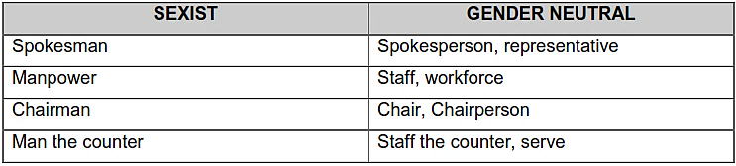
Audience Recognition
Techniques to Avoid Sexist Language
Neither refer to women as secondary nor ignore them.
Biased: “Radium was discovered by a women Marie Curie.”
Unbiased: “Radium was discovered by Marie Curie.”

Slide 27
Audience Recognition
Achieving Audience Recognition
Audience | Style | Example
High Tech Peers | Abbreviations/Acronyms OK | Please review the enclosed OP and EN.
Low Tech Peers | Abbreviations/Acronyms need parenthetical definitions | Please review the enclosed OP (Operating Procedure) and EN (Engineering Notice).
Lay Readers | No abbreviations/acronyms. Explanations instead. | By following the enclosed procedure, you can ensure that your printer will run to our engineers’ desired performance levels.

Slide 28
Objectives/Traits in Technical Writing
How to enhance the probability of comprehension for the audience?
Clarity
Conciseness
Accessible Document Design (necessary info)
Audience Recognition (specified)
Accuracy (grammar)

Slide 29
Objectives/Traits in Technical Writing
How to enhance the probability of comprehension for the audience?
Clarity
Conciseness
Accessible Document Design (necessary info)
Audience Recognition (specified)
Accuracy (grammar)

Slide 30


Accuracy
Accuracy in technical writing requires that you proof read your text.
Tips of proofreading
Let someone else read it
Use the delay approach
Read one line at a time
Read long words syllable by syllable

Slide 31
Accuracy
Use technology.
Check figures, scientific and technical equations, and abbreviations.
Read it out loud .
Use a dictionary.
Try scattershot proofing .

Slide 32
Accuracy
Organization
1-Spatial
If you are describing the parts of a machine or a plot of ground, you might organize your text spatially. You would describe what you see, as it appears in space, left to right, top to bottom, inside to outside or clockwise. These spatial sequences help your readers visualize what you see and therefore better understand the physical qualities of the subject matter.

Slide 33

Accuracy
Chronological
At 1:15 PM, we arrived at the site and assessed the patient's condition, taking vitals (pulse, respiration, etc.). At 1:17 PM after stabilizing the patient, we contacted the hospital and relayed the vitals. By 1:20 PM, the patient was on an IV drip. Our vehicle arrived at the hospital at 1:35 PM and hospital staff took over the patient's care.

Slide 34

Accuracy
Importance
If you bury key data on the bottom of a page, your reader might not see the information.
Knowing this, you can decide which ideas you want to emphasize and then place that information on the page accordingly.
Organize your ideas by importance.

Slide 35

Accuracy
Inaccurate Agenda
Miscellaneous ideas
Questions from the audience
Refreshments
Location, date and time
Subject matter
Guest speaker
Accurate Agenda
Subject matter
Guest speaker
Location ,date and time
Refreshments
Question from the audience
Miscellaneous ideas

Slide 36

Accuracy
Comparison/Contrast
Many times in business, you will need to document options and ways in which you surpass a competitor. These require that you organize your text by comparison/contrast. You compare similarities and contrast differences. For example, if you are writing a sales brochure, you might want to present your potential client alternatives regarding services, personnel, timetables and fee structures.

Slide 37


Accuracy
Problem/Solution
Every proposal and sales letter is problem/solution oriented. When you write a proposal for instance, you are proposing a solution to an existing problem. Similarly if your sales letter promotes a new product, your customers will purchase it only if their current product is inferior.

Slide 38
Accuracy
Professional excellence and ethical behaviour
Use language and visuals with precision.
Prefer simple and direct expression of ideas.
Satisfy the audience's needs for information not your own need for self-expression.
Hold yourself responsible for how well your audience understands your message.
Respect the work of colleagues knowing that a communication problem may have more than one solution.

Slide 39
Accuracy
Testing with the intended readers
For many technical documents, you need to test them on the intended readers. Show users instructions and get them to carry them out. Rework any area where users slowed down. Rethink, redesign and rewrite any area that confused users. Make sure all users can go from the start of each instruction to the end without faltering.

Slide 40
Accuracy
Understand the importance of proofreading
Use the computer’s spell check – remember, however, that a spell check will not catch:
form if you mean from
to if you mean too
except if you mean accept
Let it sit – for a day or a weekend. When the document is cold, you are more objective about the writing.
Use peer evaluations – others will see the errors we miss.
Read it out loud – sometimes we can hear errors.
Read it backwards – then you read words out of context. You cannot anticipate the next word.

Slide 41
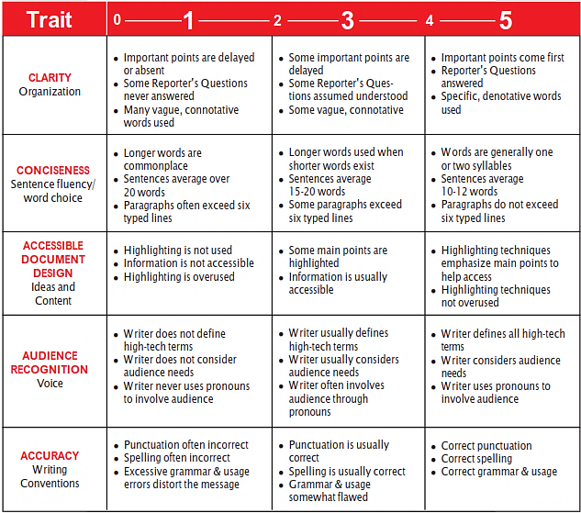
Accuracy

Slide 42
Objectives/Traits in Technical Writing
How to enhance the probability of comprehension for the audience?
Clarity
Conciseness
Accessible Document Design (necessary info)
Audience Recognition (specified)
Accuracy (grammar)

Slide 43
Conclusions
Traits in technical writing
Accessible Document Design
Audience Recognition
Accuracy

